Slide 1
Load.in
Using AI and Computer Vision to give your move a game plan.
Team Yellow
Feasibility Presentation
Old Dominion University
10/10/2020
Notes:
This slide is an animated version of the previous slide. (Title slide)

Slide 2
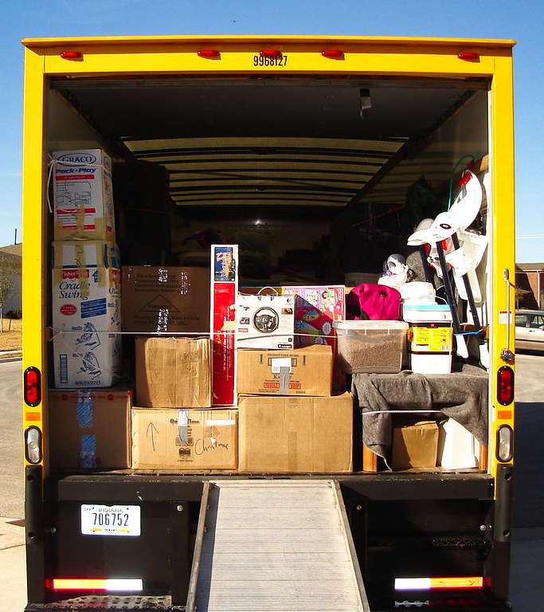
Load.in
Using AI and Computer Vision
to give your move a game plan.
Team Yellow
Feasibility Presentation
Old Dominion University
10/10/2020
Notes:
This slide is a non-animated version of the following slide. (Title Slide)

Slide 3
Contents
Team Biography: 4
The Problem: 5-13
Problem Statement: 5
Problem Characteristics: 6-10
Summary: 11
Current Process Flow: 12-13
The Solution: 14 – 21
Solution Statement: 14
Solution Characteristics: 15
New Process Flow: 16-19
Feedback Loop: 20
Functional Components: 21
References: 29
Glossary: 30

Slide 4



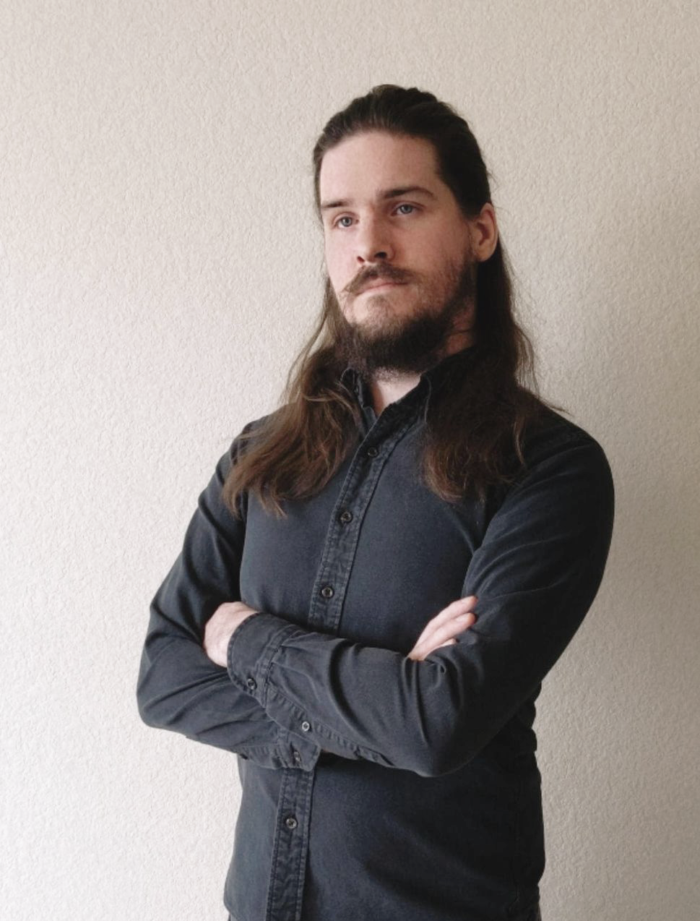



Who is Team Yellow?
Byron Aquilino
Lance Perdue
Greg Kukanich
Jason Moran
Daniel Reyna
Chris Miller
Paul Rodriguez

Slide 5

“Do It Yourself” movers lack the expert knowledge required to handle the logistics of their move.
This Photo by Unknown Author is licensed under CC BY
Notes:
TODO: change the graphic to something more subtle (Completed by Lance)
Photo source: https://www.theritemove.com/2019/09/30/game-plan-making-sure-you-pack-up-everything-of-importance/

Slide 6
Professional Movers Are Costly
Notes:
https://www.hireahelper.com/movers-academy/on-the-job/estimating-job-times/
https://www.uhaul.com/Reservations/RatesTrucks/
https://www.move.org/average-cost-truck-rental/
https://www.victoryvan.com/moving-and-storage/how-long-takes-move-new-house
https://www.movers.com/moving-guides/moving-four-bedroom-house-costs.html

Slide 7
35% of Americans are stressed the most by logistics and packing.
Article.com
10/10/2020
CS 410 – Team Yellow – Load.In – Feasibility
7
Notes:
7

Slide 8
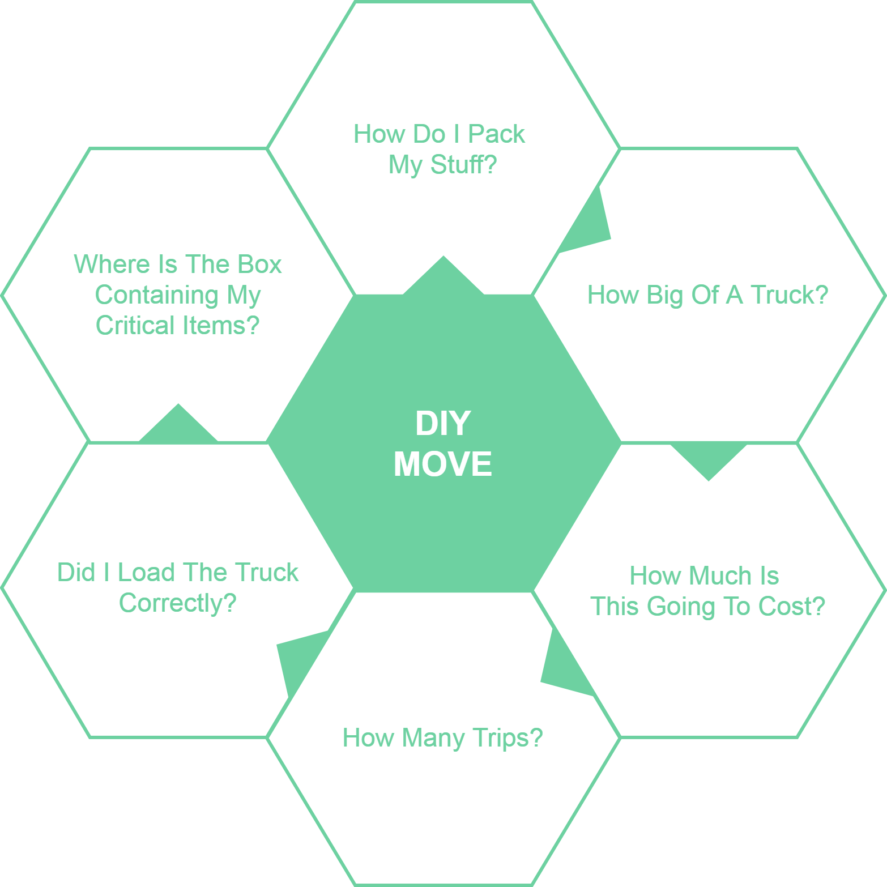
Notes:
TODO: Change graphic, change top from “How many boxes” to “How do I pack my belongings?”
Change “pack the truck” to “load the truck”

Slide 9
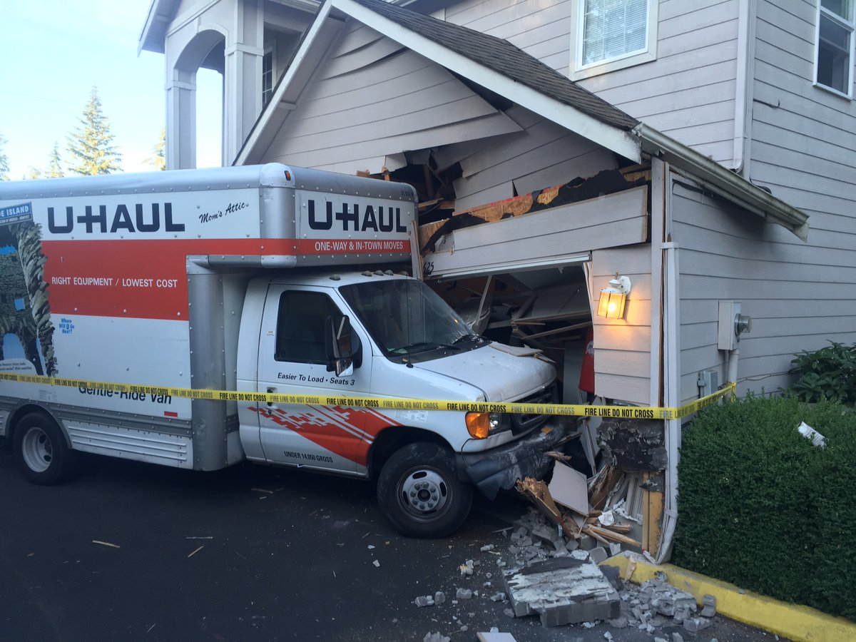
Loading can be a major issue
Poor loading can cause
Property damage
Car accidents
An estimated 50,000 accidents related to trailer towing occur each year.
This Photo by Unknown Author is licensed under CC BY
Hayesbc.com

Slide 10
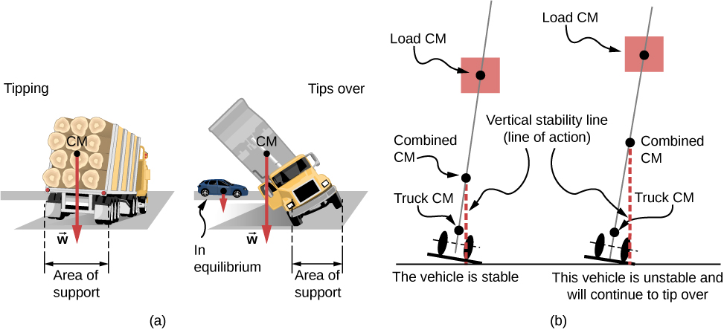

Major Truck Loading Considerations
Weight distribution
Protecting fragile items
This Photo by Unknown Author is licensed under CC BY
PenskeTruckRental.com

Slide 11
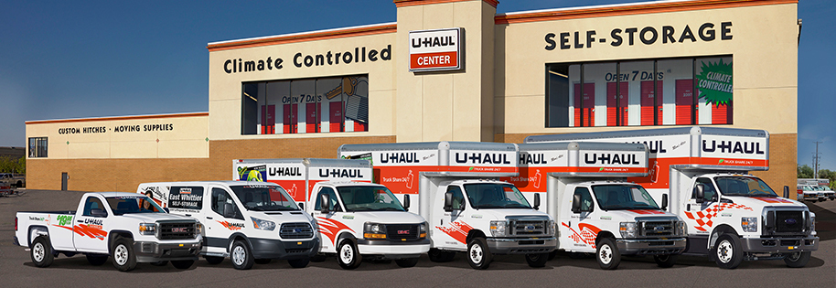
Figuring out what to rent is hard!
Accurately determining
How big of a truck to get
How many trips a move will take …is difficult.
Rental Truck companies base their business model on this!
This Photo by Unknown Author is licensed under CC BY
wtkr.com

Slide 12
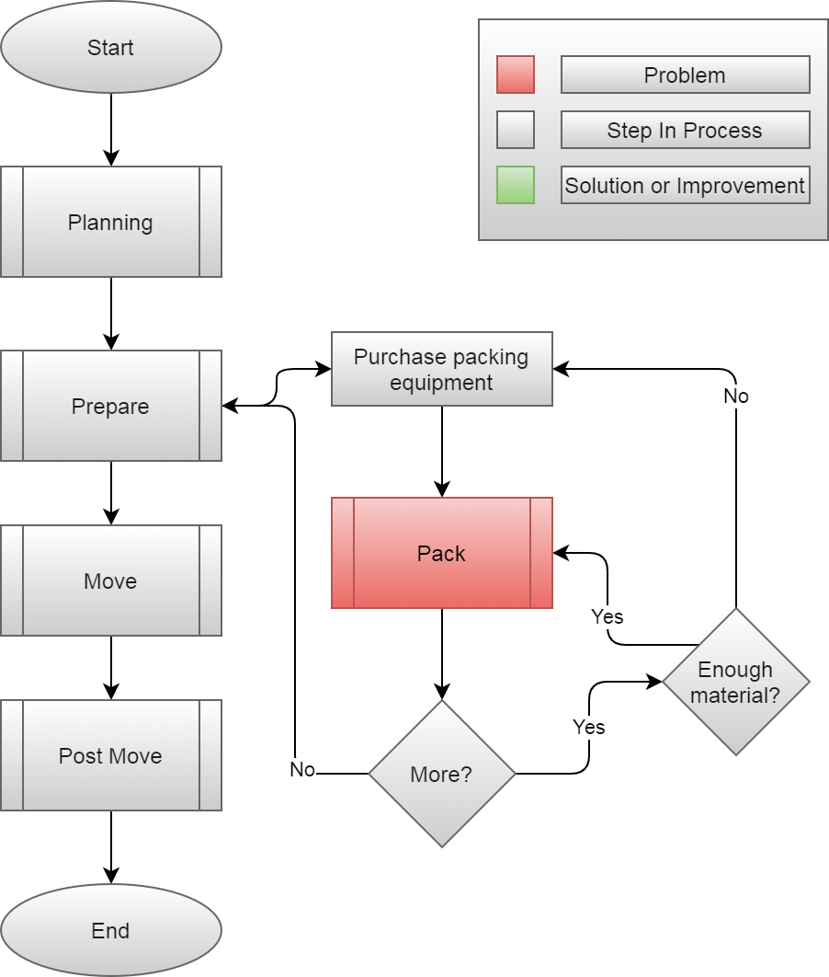
Current Process

Slide 13
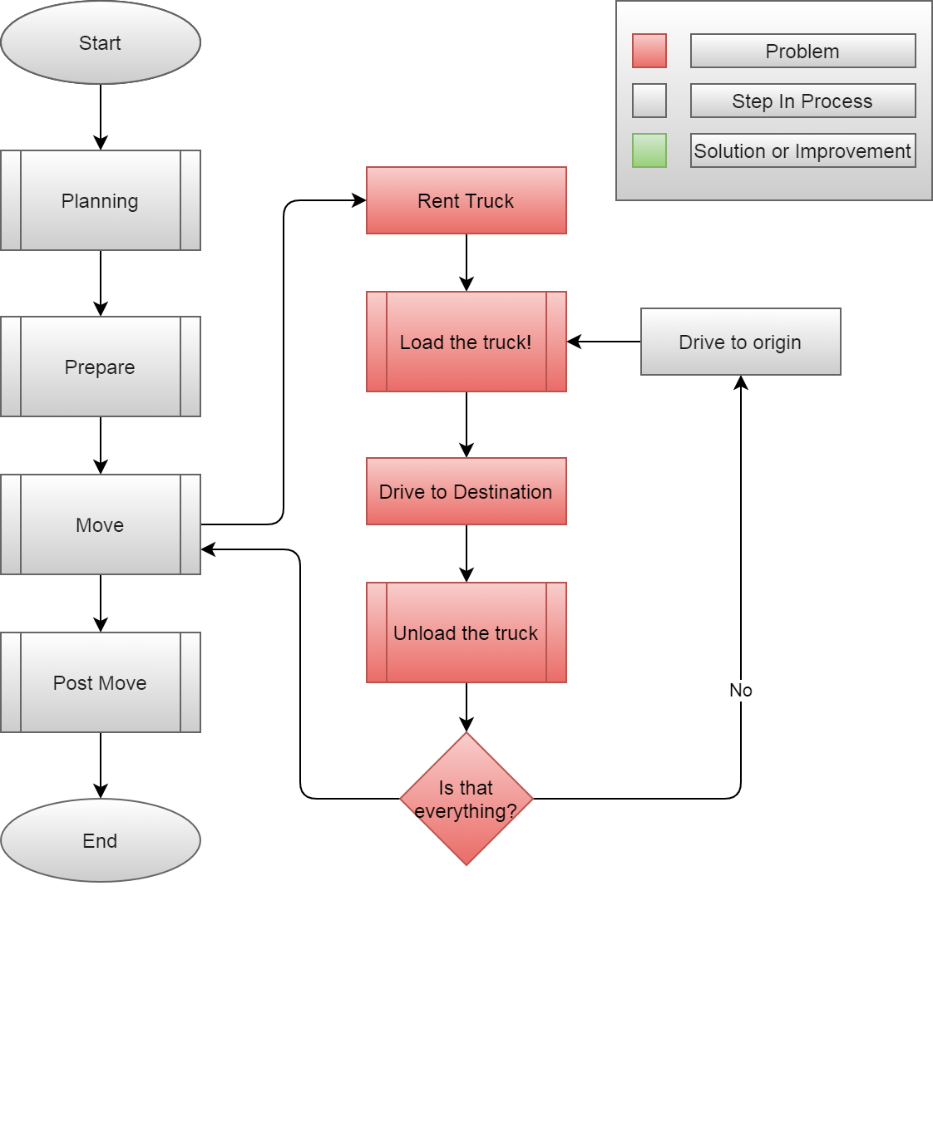

Slide 14
Summary
DIY Movers are faced with many challenges
Properly loading truck
Protecting valuables
Finding the best deal
Keeping track of every box
All during an already stressful life event!

Slide 15

Load.In gives your move a game plan
Uses artificial intelligence and computer vision
Customized Expert-Level truck loading instructions
Takes in to account weight, priority, fragility
Navigable 3D map of interior of truck: never lose a box
Uses 3D measurements to find you the best deal
Also Provides expert packing tips and tricks
This Photo by Unknown Author is licensed under CC BY
Notes:
Source for image https://www.realtor.com/advice/move/unpack-like-a-pro/

Slide 16
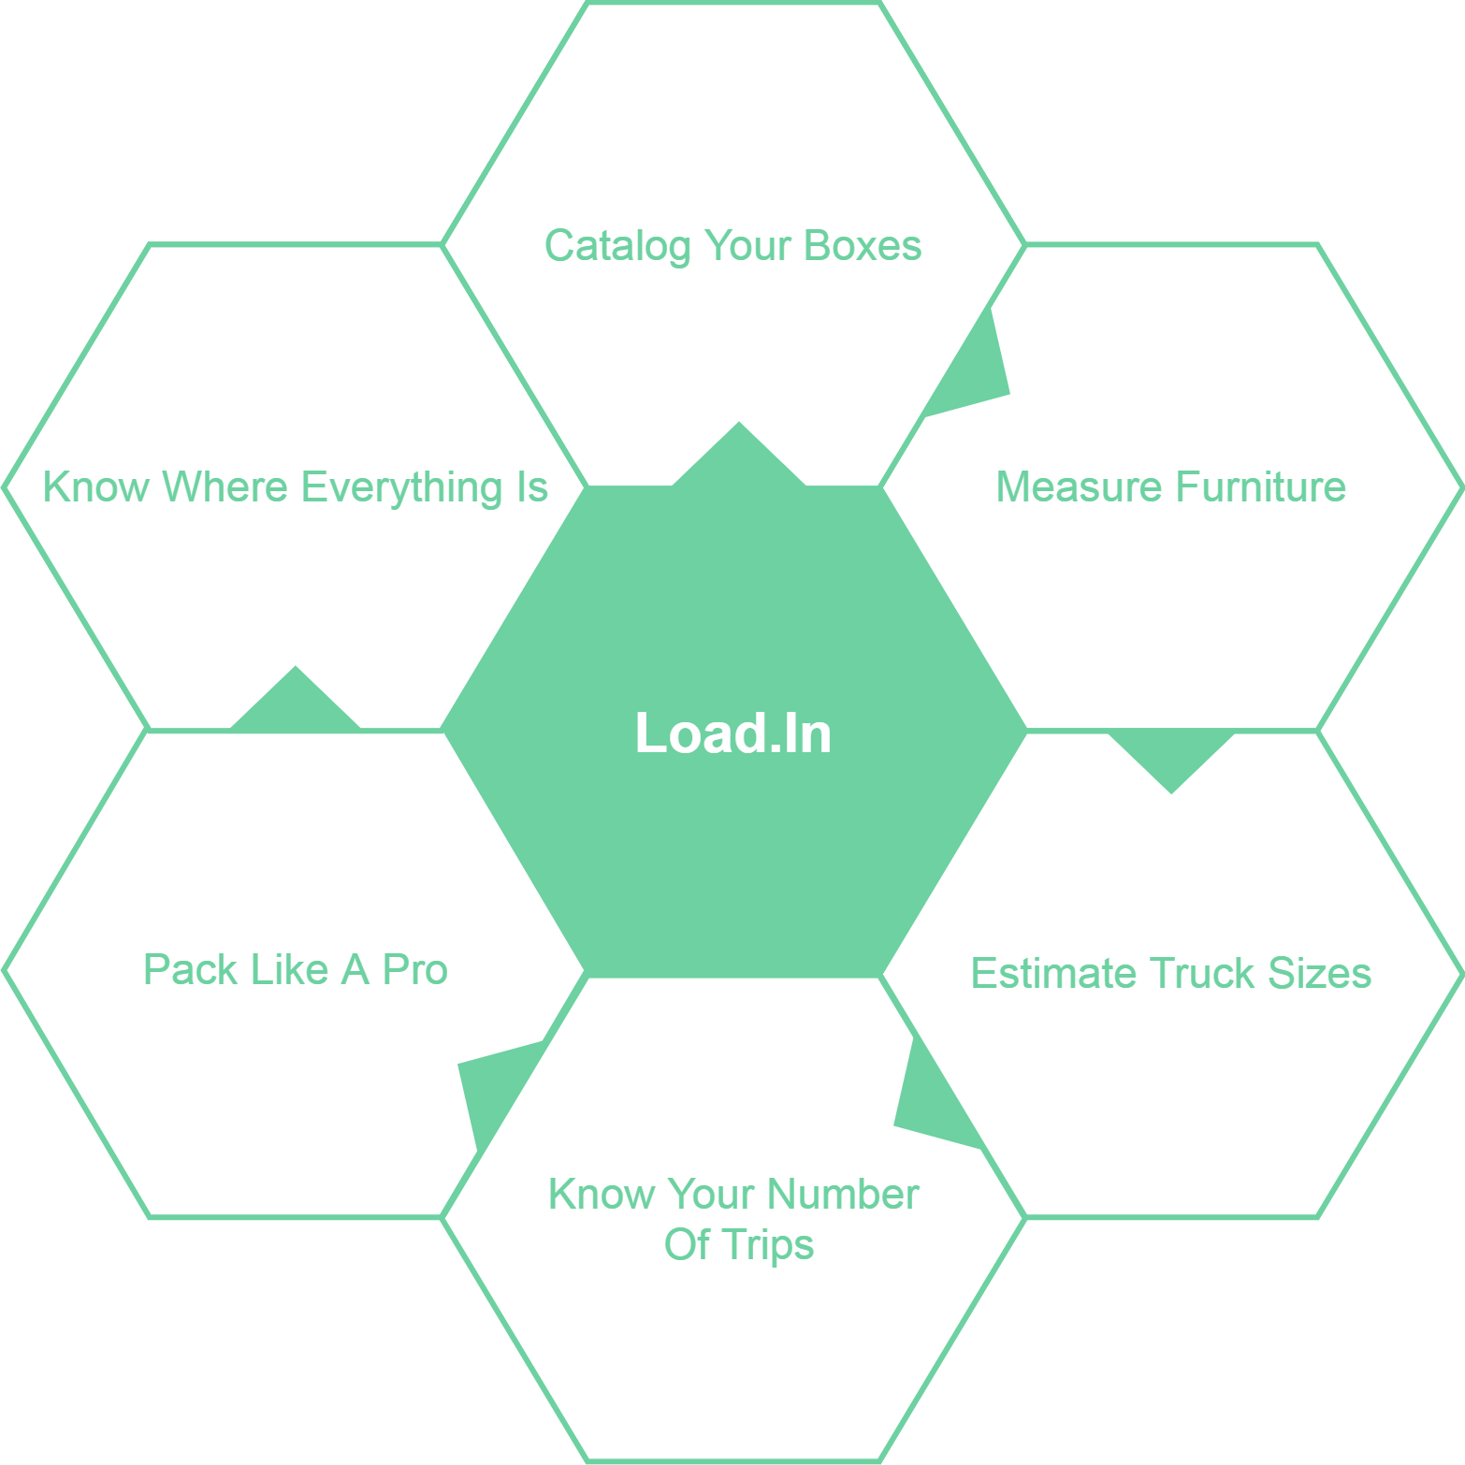
What Can Load.In Do
For You?

Slide 17


1. The user will use their phone camera to capture multiple images of objects that need to be loaded.
Notes:
Copied blindly from Jason’s original presentation, needs adjusting.

Slide 18
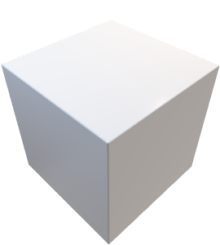



2. Using photogrammetry, Load.In will create 3D models from those images
Notes:
Copied blindly from Jason’s original presentation, needs adjusting.

Slide 19
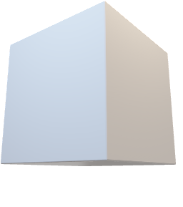
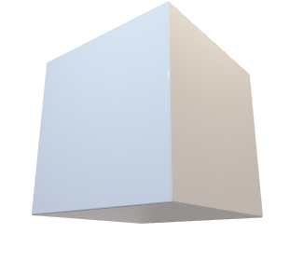
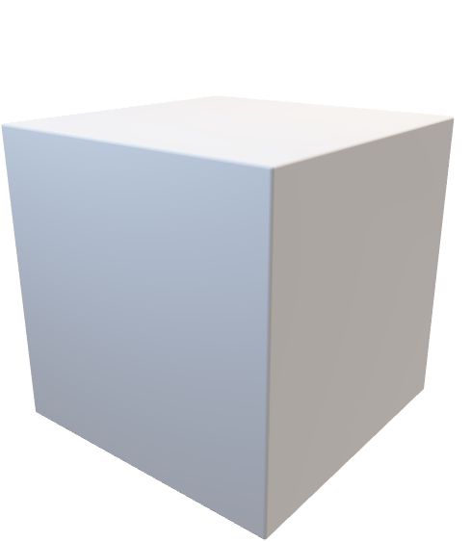
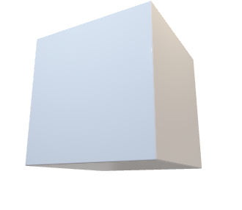
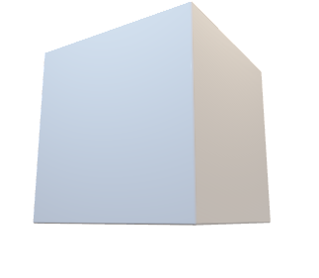

3. Calculate optimal loading configuration and provide loading instructions to the user
Notes:
Copied blindly from Jason’s original presentation, needs adjusting.

Slide 20
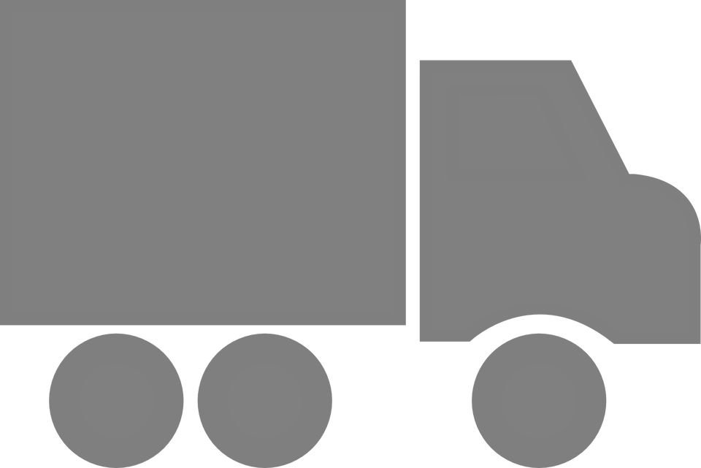


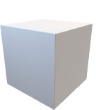



4. The user can navigate a 3D map showing the location of every box in the truck
kitchen
garage
Notes:
Copied blindly from Jason’s original presentation, needs adjusting.

Slide 21
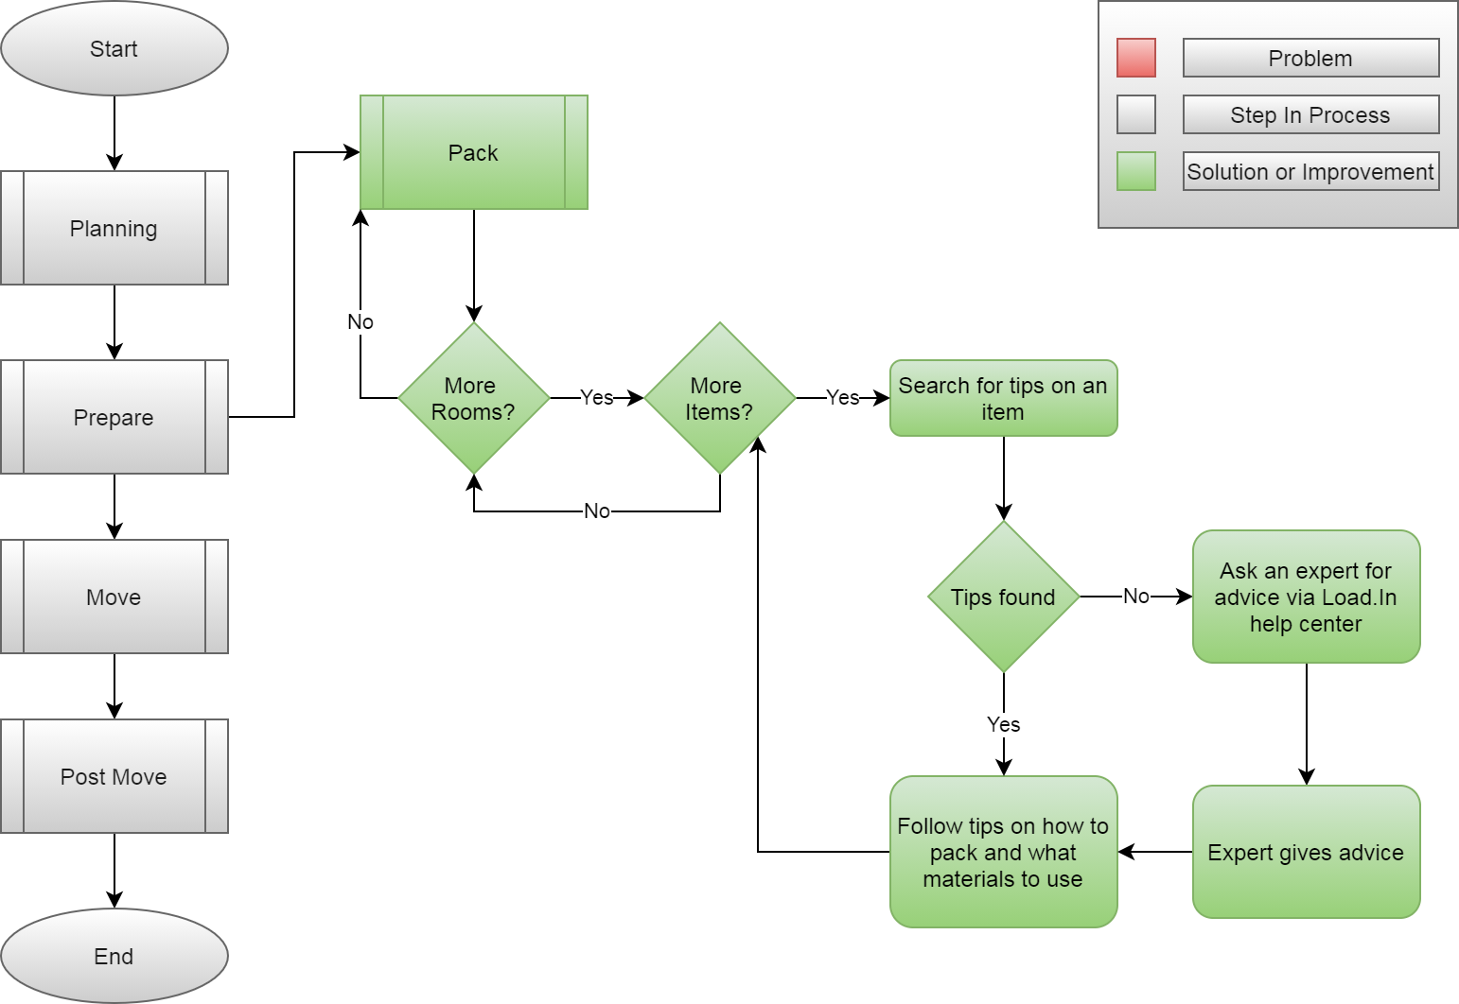
How will the solution help?

Slide 22
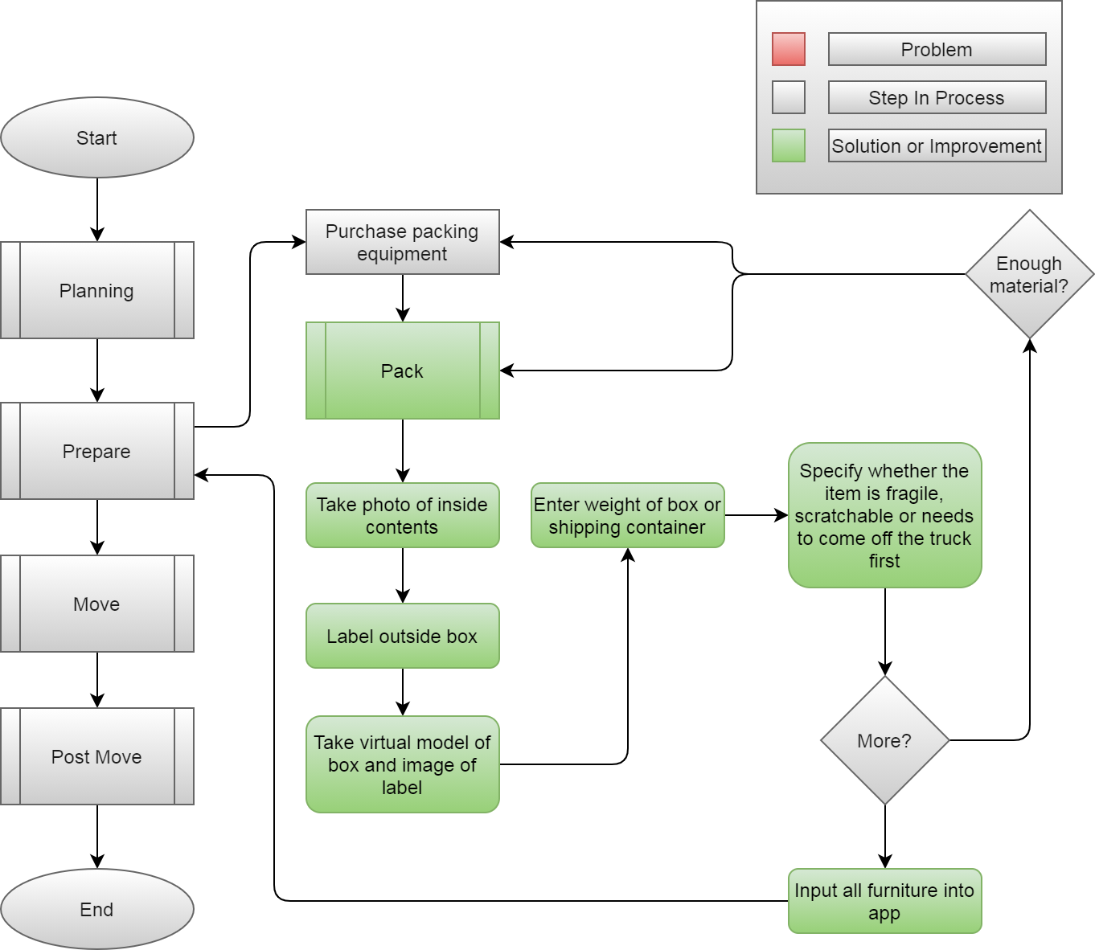

Slide 23
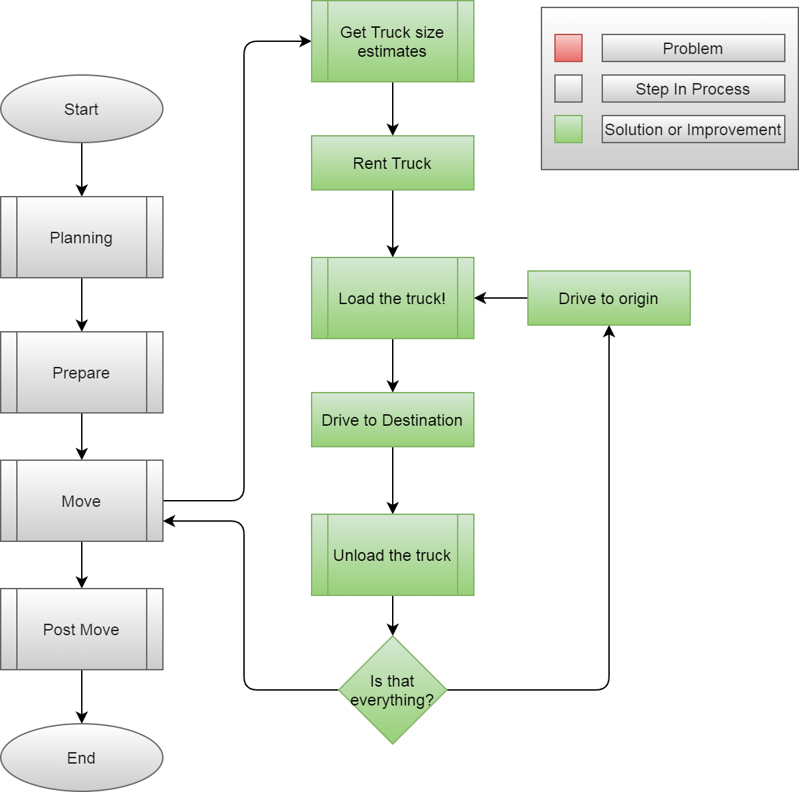

Slide 24
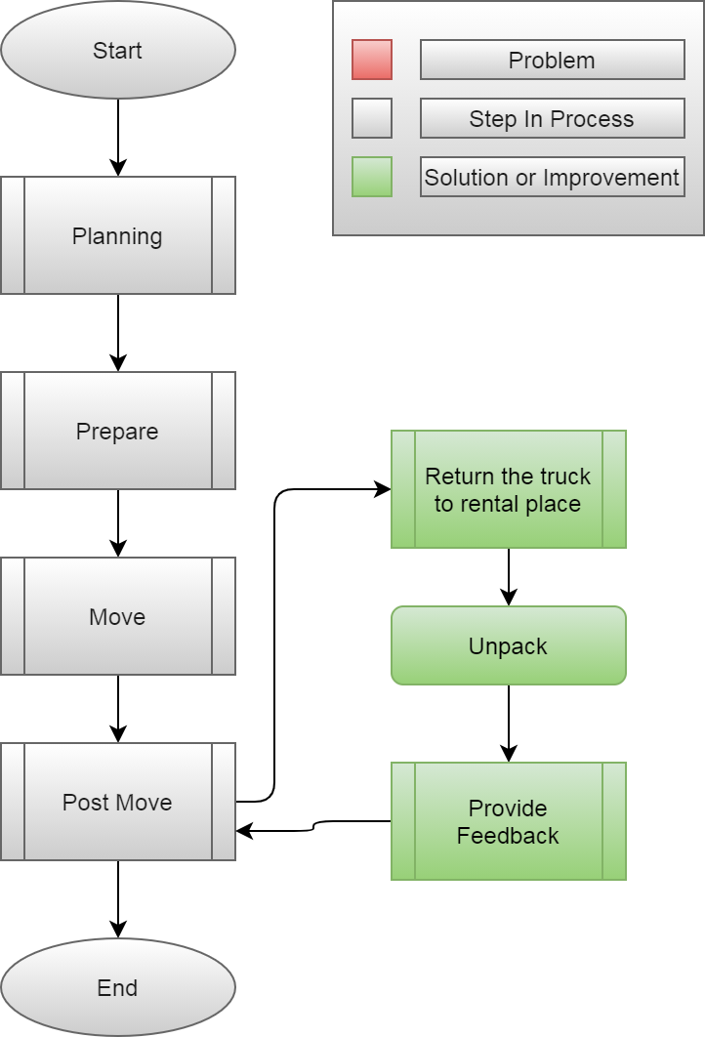

Slide 25










Feedback Loop
Input
4
3
Training data
6
5
2
1
Pro loading strategy
Neural Network
App generates 3D models of objects to move
Output
Incorporate Feedback in to training data generation
Experience
Instructions
User gives feedback
User follows plan
Loading Plan

Slide 26
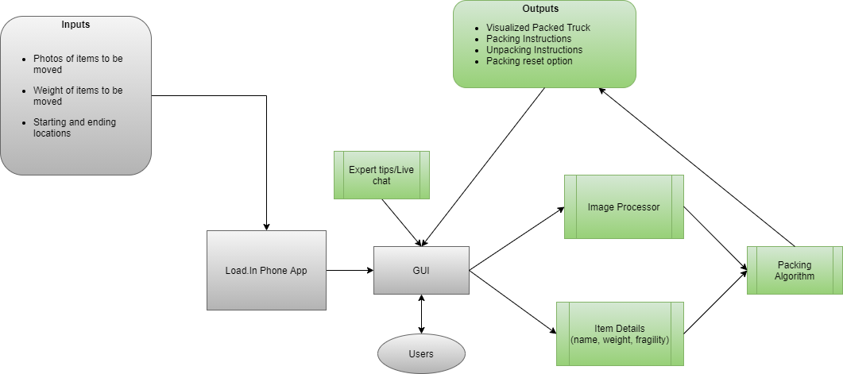
Major Functional Components

Slide 27
What Load.In Will Do
Assist in the packing process with expert advice
Catalog with photos all boxes, furniture, and other items that are going to be placed in the truck
Generate instructions for properly loading the truck based on weight distribution, item safety, best fit space utilization, and item(s) priority
Use photos taken to Create a 3D model of how everything should be expertly packed in the truck
Will provide location information for different boxes and items within the truck using 3D model and cataloging
Give estimate for appropriate rental truck size and number of trips dependent on truck size

Slide 28
What Load.In Won’t Do
Replace Manual Labor
Pack boxes
Load or unload truck
Assist in the driving process

Slide 29
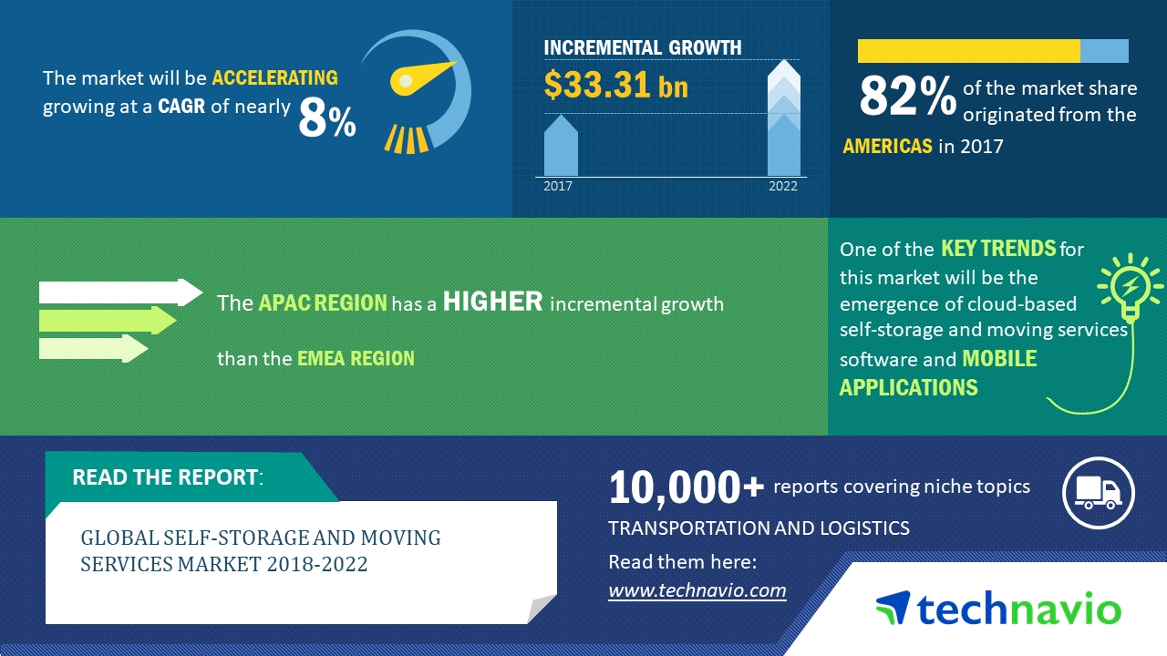
The Moving Industry Market
Nearly all moving companies are either all inclusive or DIY
However the all inclusive services are often very expensive
All of the DIY services provide no assistance or guidance and lead to confusion and wasted money
The market is shifting towards software being utilized to increase efficiency and decrease costs
This Photo by Unknown Author is licensed under CC BY

Slide 30
Benefits to the Customer
Users of the application will benefit from:
Being shown how to pack boxes for increased organization.
Being shown how to properly load their truck for increased efficiency.
Being provided with a database of useful tips from professional movers.
Saving of money and time due to the entire moving process being made more efficient.

Slide 31
Technical Risks
Probability
 |  | Very Low | Low | Medium | High | Very High
Severity | Very High |  |  |  |  | T-3
 | High |  |  | T-4 | T-1
 | Medium |  |  | T-2
 | Low
 | Very Low
T-1: Artificial Intelligence prone to error due to insufficient training data.
T-1 Mitigation: Implementing a feedback loopback in the beta phase with test users.
T-2: Challenge to obtain accurate and timely feedback.
T-2 Mitigation: Implement a feature for users to give feedback if the application operated correctly after completing a move.
T-3: Current technology involving machine vision is a challenge.
T-3 Mitigation: Conduct a prototype to mitigate risk of critical errors upon release.
T-4: Key developer leaves the project and creates a knowledge gap.
T-4 Mitigation: Ensure team members collaborate and share knowledge equally throughout the projects lift cycle.

Slide 32
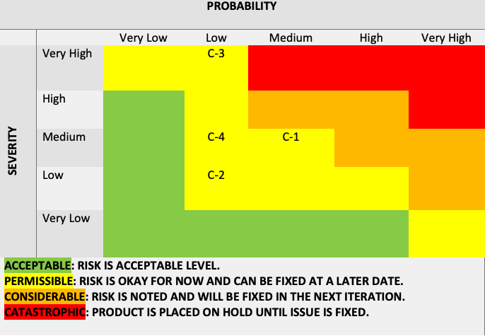
Customer Risks
C-1: End user is inexperienced with the application.
C-1 Mitigation: Implement a tutorial on how to use the application and provide a help feature.
C-2: End user finds UI challenging to operate.
C-2: Mitigation: Implement analytics for tracking when a user stop using the application.
C-3: End users are not satisfied with the recommendations of the application.
C-3 Mitigation: Implement a customer feedback feature that allows the users to disclose his/her issues with the applications.
C-4: End user doesn’t follow the guidelines of the application.
C-4 Mitigation: Implement a feature that allows the user to repeat/reset certain steps in the application as they progress.

Slide 33
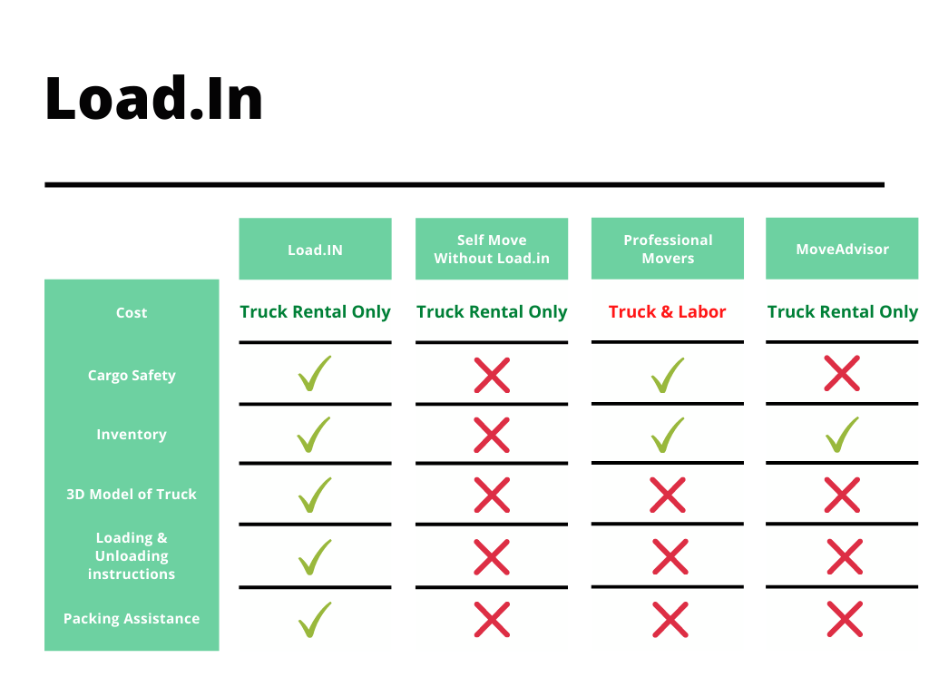
The Competition

Slide 34
Conclusion
DIY Movers are faced with many logistical difficulties
Properly loading truck
Protecting valuables
Finding the best deal
Keeping track of every box
All during an already stressful life event!
Load.In will provide customized expert instructions
Truck loading instructions based on photogrammetry
Cost minimization based on input data
Map of truck available to assist in finding boxes

Slide 35
Notes:
End of presentation.

Slide 36
Sources:
The Top 5 Moving Mistakes Across America. (2019, August 13). Article. https://www.article.com/blog/top-5-moving-mistakes/
Economy Moving & Storage, LLC. (2015, January 4). How to properly pack and load a moving truck- Movers Cincinnati. YouTube. https://www.youtube.com/watch?v=rjmofUZOdwo&feature=youtu.be
CADCode Systems. (n.d.). Optimizing & Machining | CADCode Systems. CADCode.Com. Retrieved September 20, 2020, from https://www.cadcode.com/category/categories/optimizing-machining
Dube, E. (2020, September 20). OPTIMIZING THREE-DIMENSIONAL BIN PACKING THROUGH SIMULATION. Semantics Scholar. https://www.semanticscholar.org/paper/OPTIMIZING-THREE-DIMENSIONAL-BIN-PACKING-THROUGH-Dube/bb9986af2f26f7726fcef1bc684eac8239c9b853#references
Knoblauch, M. (2019, May 8). One in ten Americans would prefer a week in jail over moving. New York Post. https://nypost.com/2019/05/08/one-in-ten-americans-would-prefer-a-week-in-jail-over-moving/
The American Institute of Stress. (n.d.). The Holmes-Rahe Stress Inventory PDF. Retrieved September 20, 2020, from https://www.stress.org/wp-content/uploads/2019/04/stress-inventory-1.pdf
Wood, T. (2020, January 6). Moving Industry Statistics. MoveBuddha. https://www.movebuddha.com/blog/moving-industry-statistics/
Nat and Friends. (2017, April 18). Google Earth’s Incredible 3D Imagery, Explained. YouTube. https://www.youtube.com/watch?v=suo_aUTUpps&feature=youtu.be
Collins, T. (2018, April 20). A Look Into Photogrammetry and Video Games - Tiger Collins. Medium. https://medium.com/@homicidalnacho/a-look-into-photogrammetry-and-video-games-71d602f51c31

Slide 37
Glossary:
*All definitions are sourced from Wikipedia
Photogrammetry
Photogrammetry is the science and technology of obtaining reliable information about physical objects and the environment through the process of recording, measuring and interpreting photographic images and patterns of electromagnetic radiant imagery and other phenomena.
Algorithm
A finite sequence of well-defined, computer-implementable instructions, typically to solve a class of problems or to perform a computation.
Professional movers
Professionals who move all your belongings for you from one place to another.
Packing problems
Are a class of optimization problems in mathematics that involve attempting to pack objects together into containers. The goal is to either pack a single container as densely as possible or pack all objects using as few containers as possible.

